Slide 1
Animal Magic
Practice management app for vets - Peter Mordaunt

Slide 2
Brief
A veterinary practice has approached you to build a web application to help them manage their animals and vets.
Vets look after MANY animals
Animals have a SINGLE vet
Owners can have MANY animals
Animals have a SINGLE owner
Animals & Vets can have MANY appointments

Slide 3
Brief - Functionality
Be able to assign or register Pets with Vets
CREATE – Pets, Vets, Owners & Appointments
READ – Vet, Pet & Owner records, Appointment details and notes.
UPDATE – Owners & Pet records, Vet Details, Appointment Notes
DELETE – Pets or Vets that leave the practice.

Slide 4

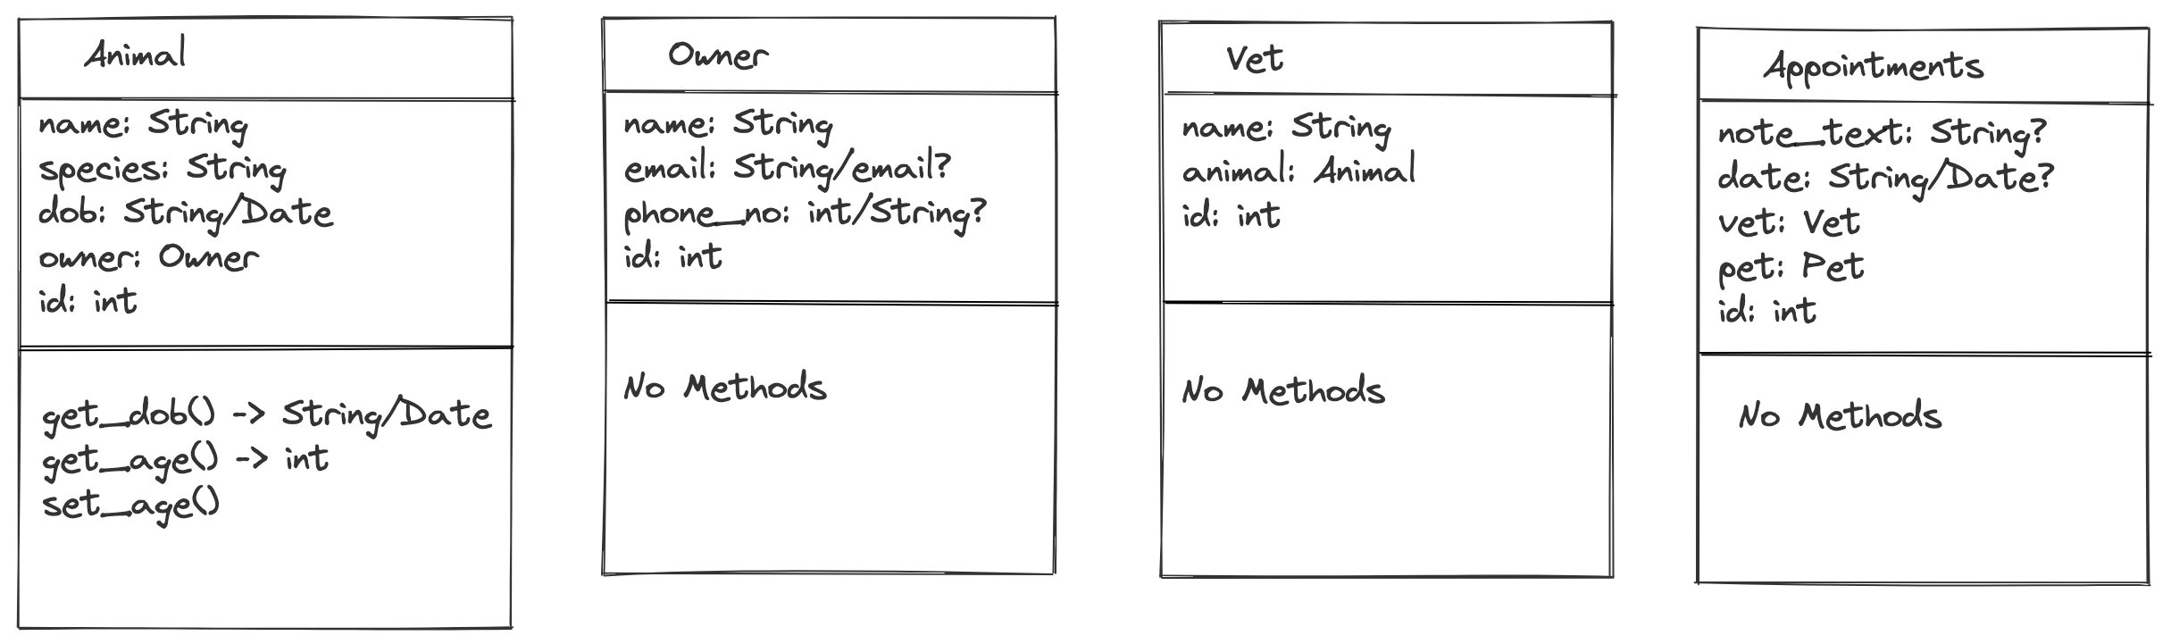
Planning
Class Diagrams

Slide 5
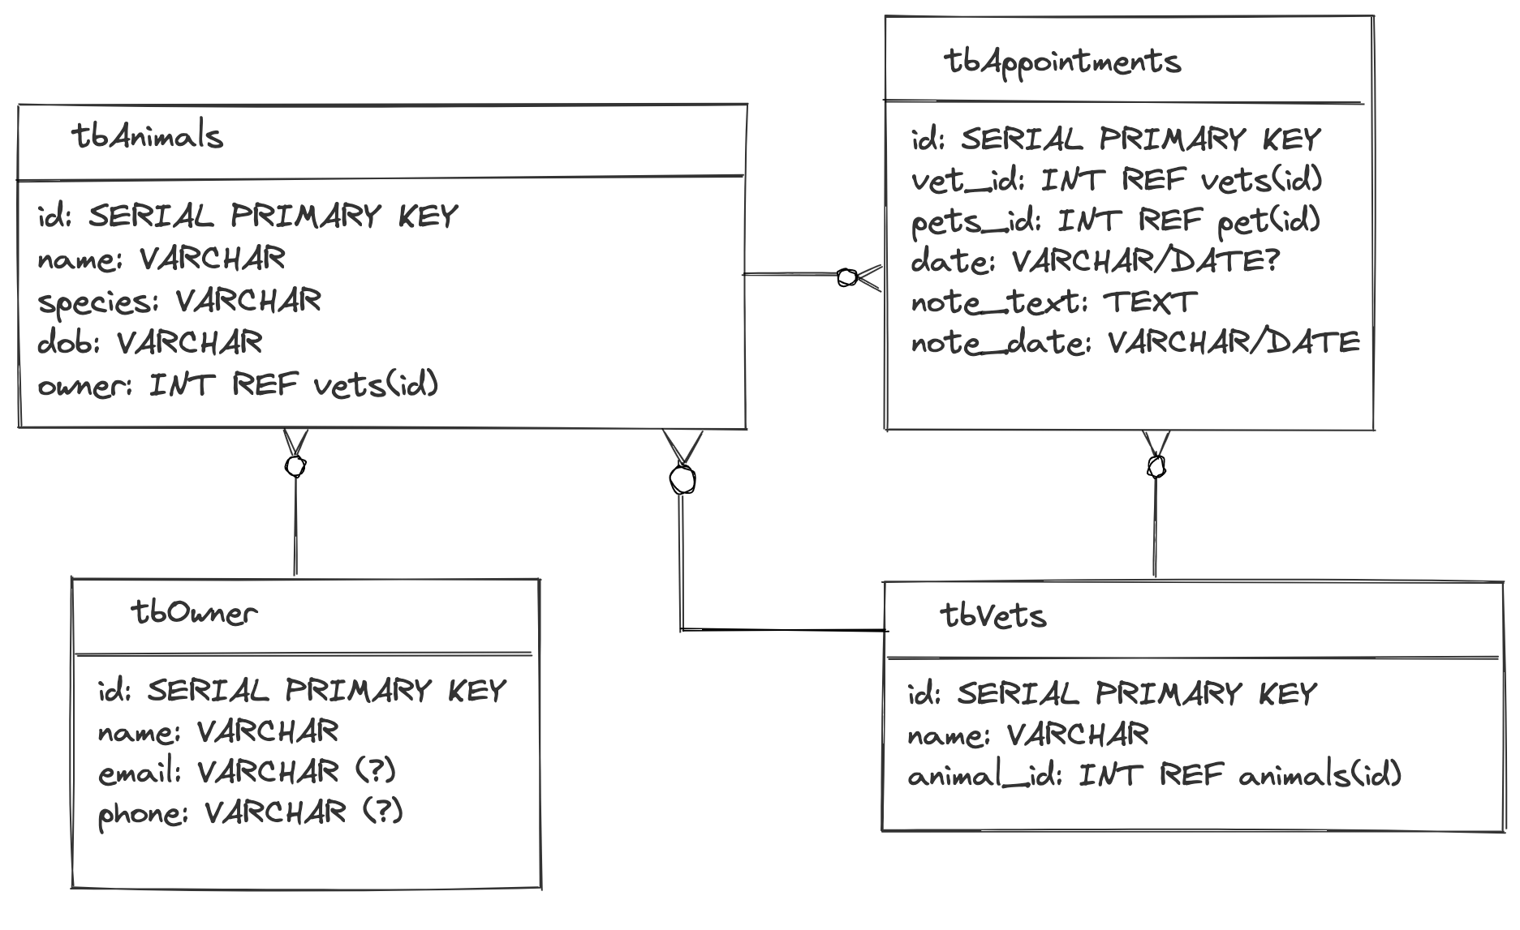
DB
Table
Diagrams

Slide 6
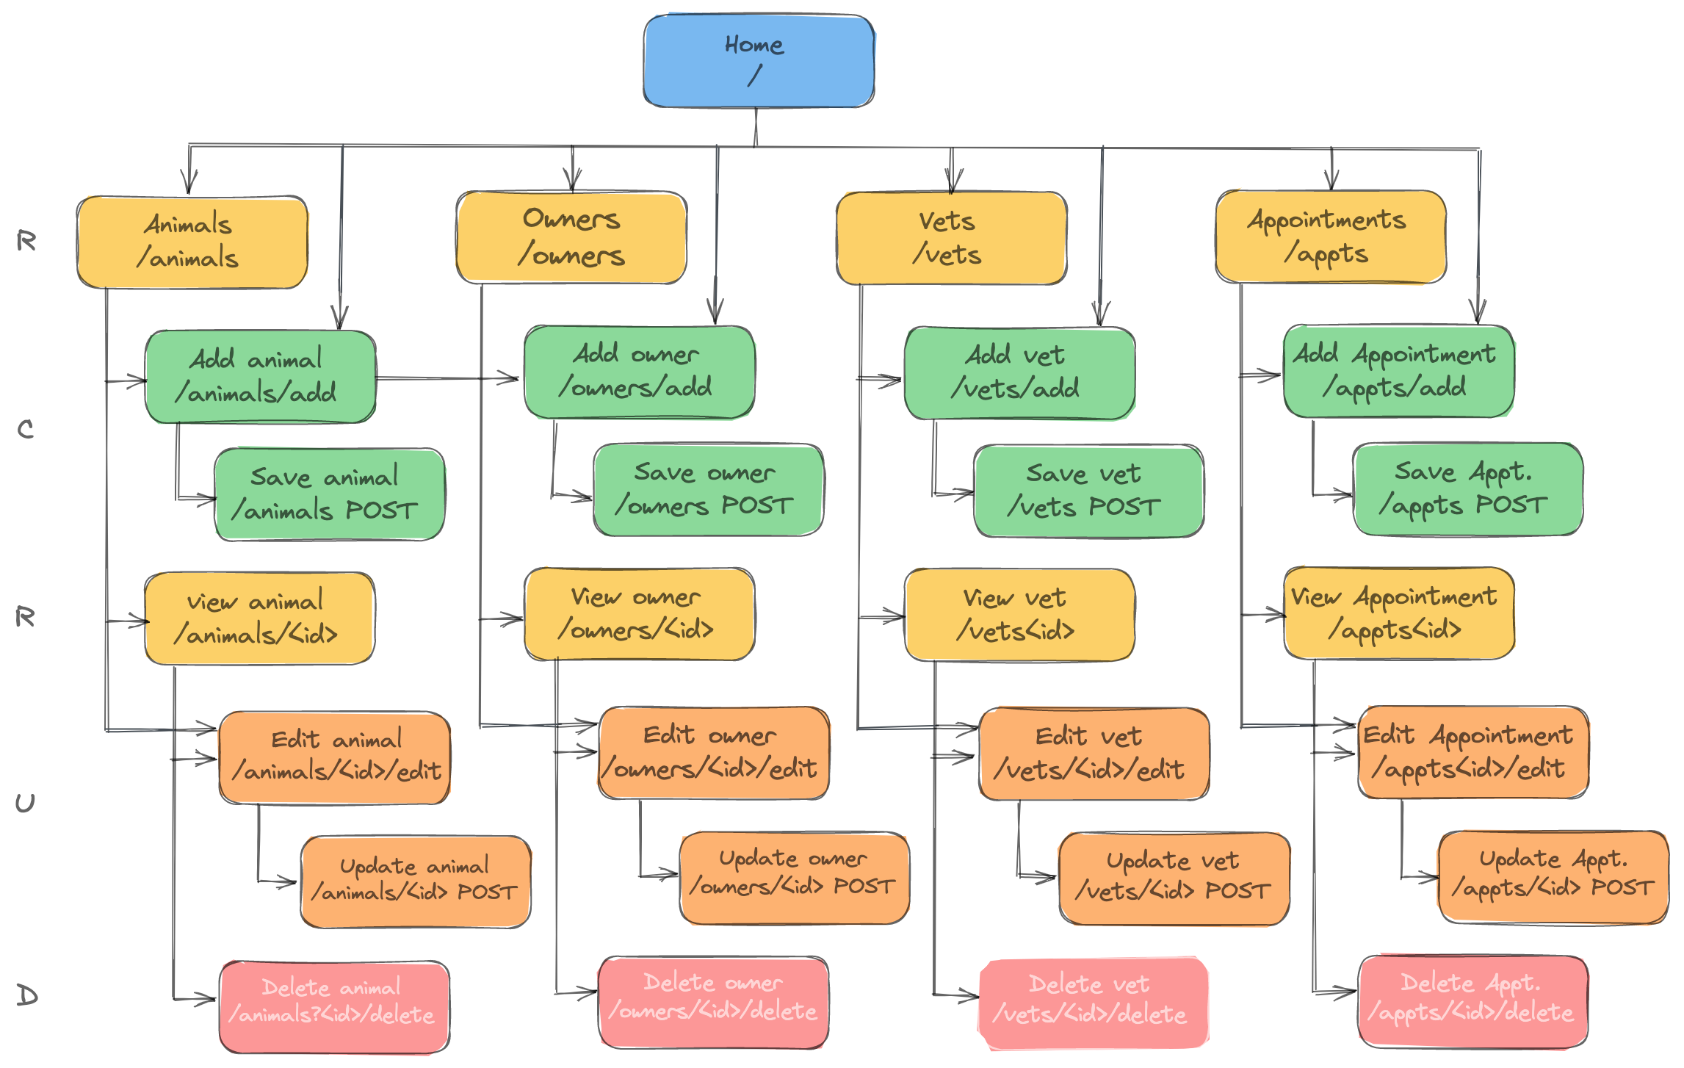
Site
Map

Slide 7
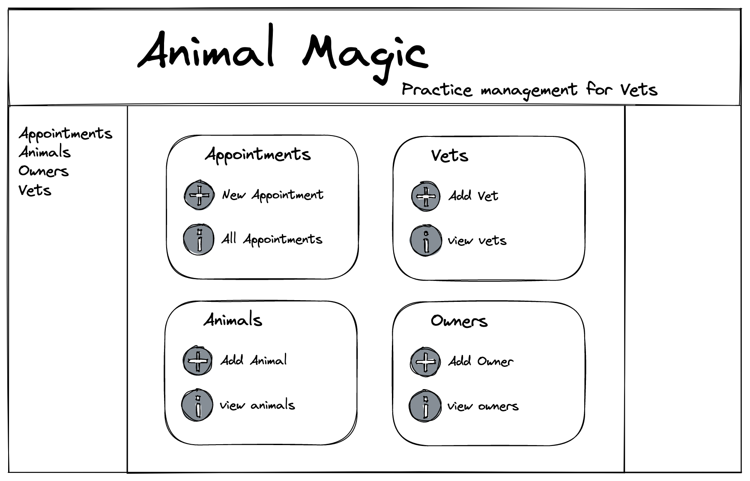
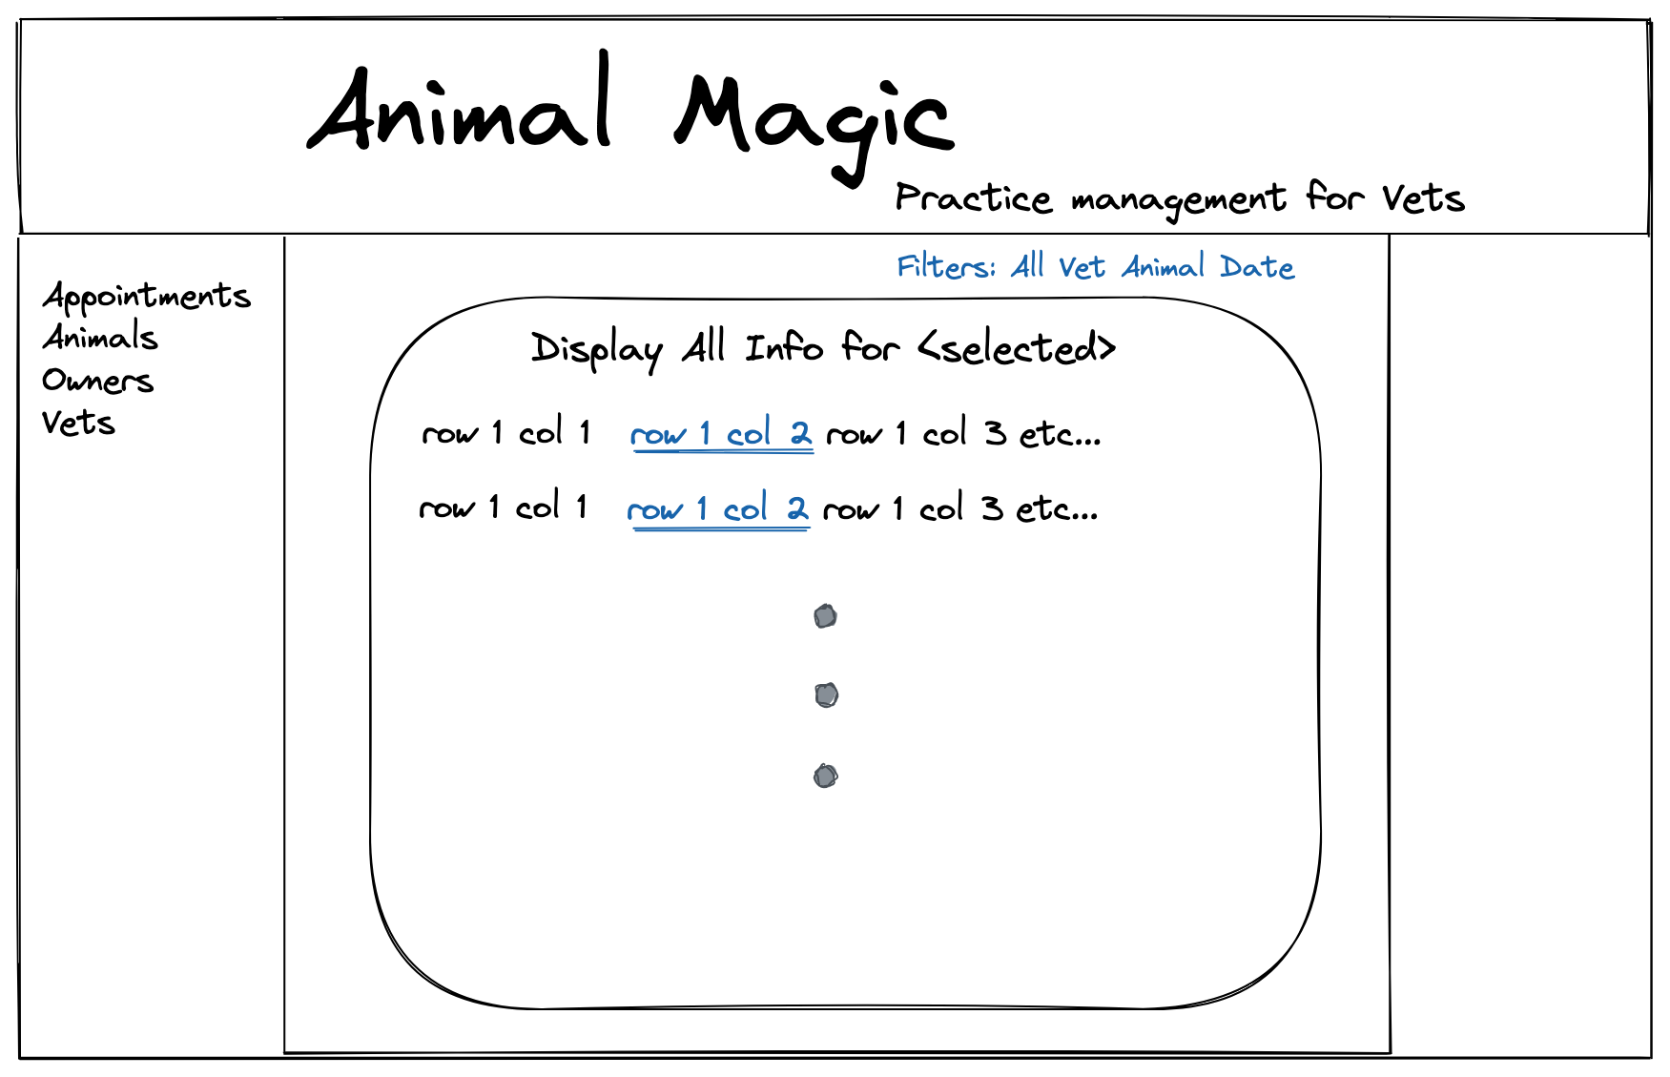
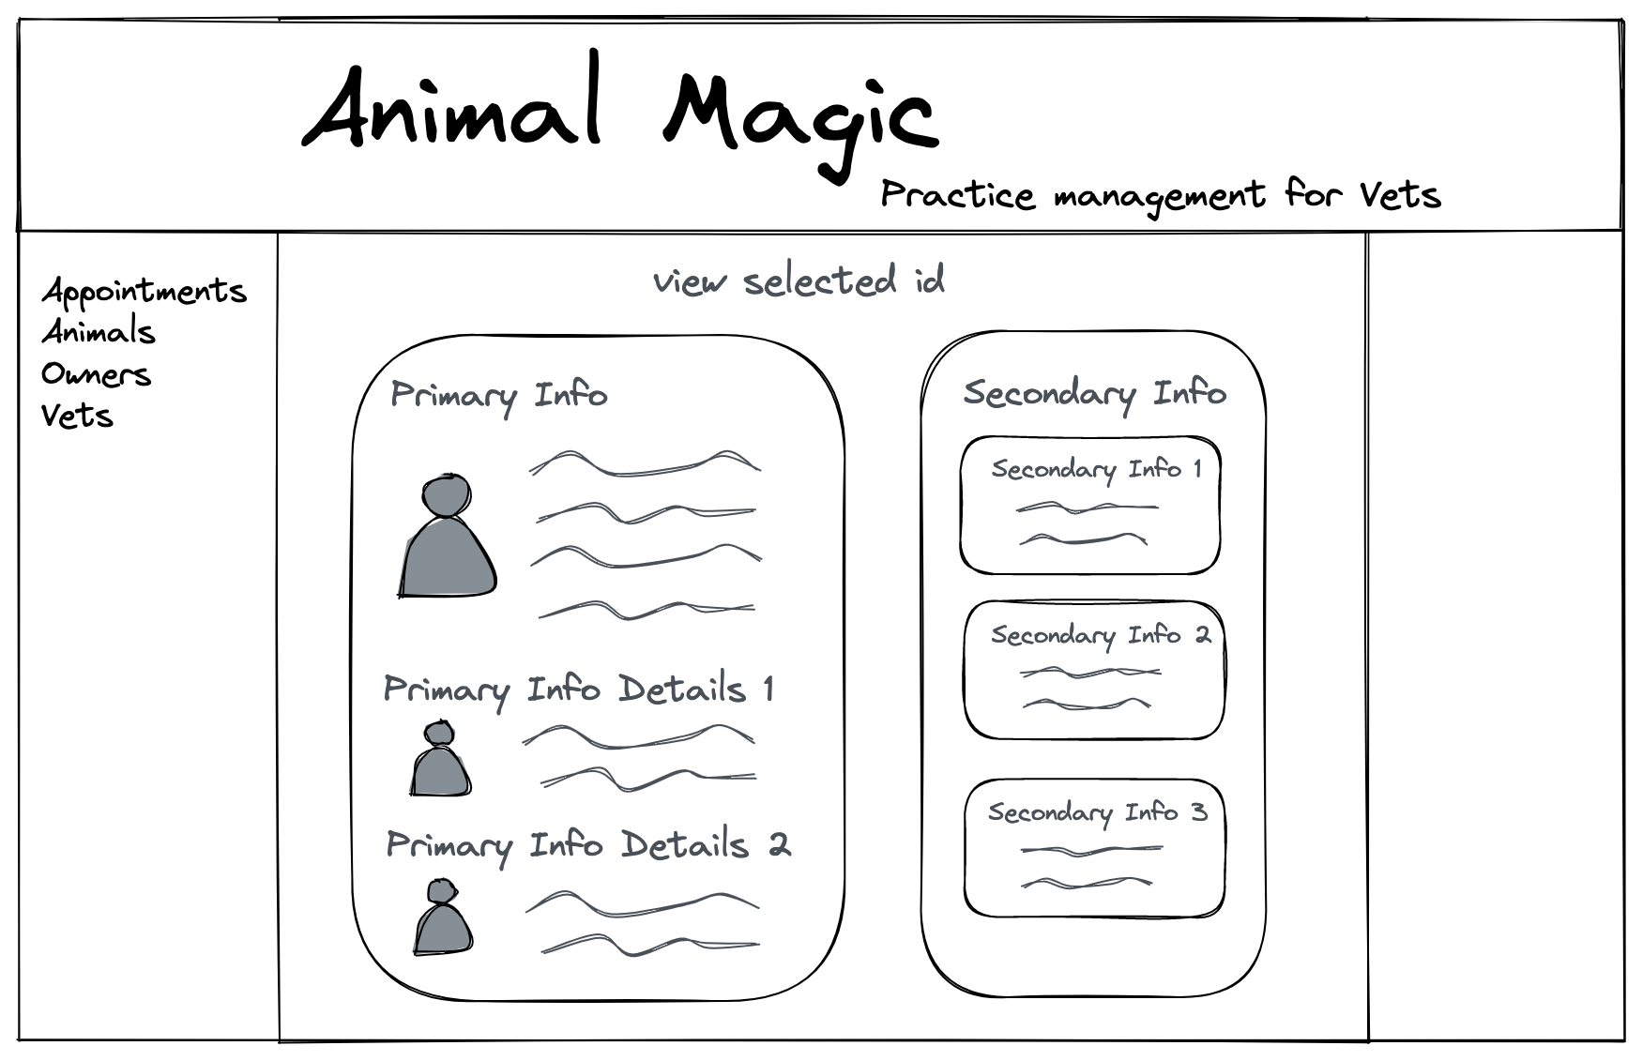
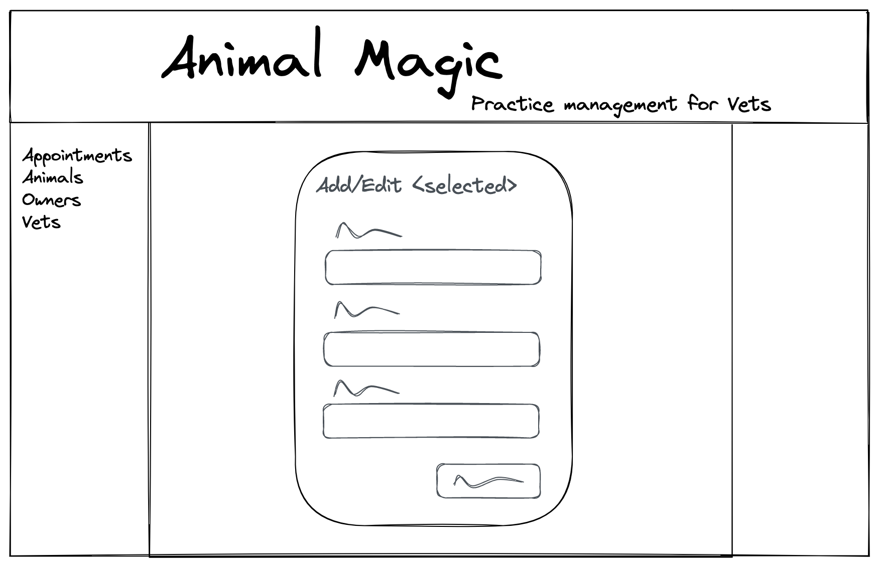
Wireframes

Slide 8
Demo time

Slide 9
Extension Ideas- Must, should, could, won’t
Add warning message for deleting (should) ->Javascript
Set vet for making appts so not editable(should)
Add confirm message for updates (Should) -> Javascript
Age or dob option? (should) could solve with dummy dob based on reg date & dob known bool
Add all appointments in aside on view selected page (should)
Add animals/owners/vet in second aside (should)
Make all fields required when adding new entries(should)
sort appointments by date, animal, vet, owner (should)
Add submenu items – add/edit/all (should)
Add pages to list results (could)
Add short note with option to expand (could)
Filter by in clinic – handle check in/out (could)
Check if owner exists when add new owner (could)
Media queries – collapsible menus etc (could)
Login page – different views for user type, ie Vet or Reception (could)
Billing? (Could)
Online booking (won’t)

Slide 10
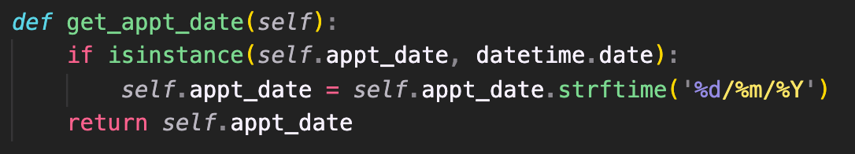
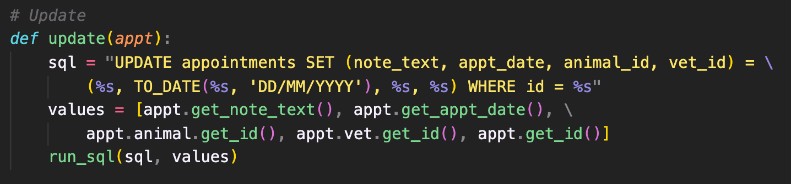
Favorite bit of code?

Slide 11
Learning Objectives
Get more comfortable:
Using SQL
Working with Routes
Experimenting with CSS & HTML

